Slide 1
Frequency Distributions

Slide 2
Grouped Data Vs Ungrouped Data
Ungrouped data – Data that has not been organized into groups.
Also called as raw data.
Grouped data - Data that has been organized into groups (into a frequency distribution).
Data | Frequency
2 | 8
3 | 4
5 | 6
7 | 7
8 | 2
9 | 5
Data | Frequency
2 – 4 | 5
5 – 7 | 6
8 – 10 | 10
11 – 13 | 8
14 – 16 | 4
17 – 19 | 3

Slide 3
Creating a Categorical Ungrouped Frequency Distribution
Step 1: Make a table with the following columns in order: class, tally, and frequency
Step 2: Tally (TOTAL) the data and place the results in the tally column.
Step 3: Count the tallies and place the results in the frequency column.

Slide 4
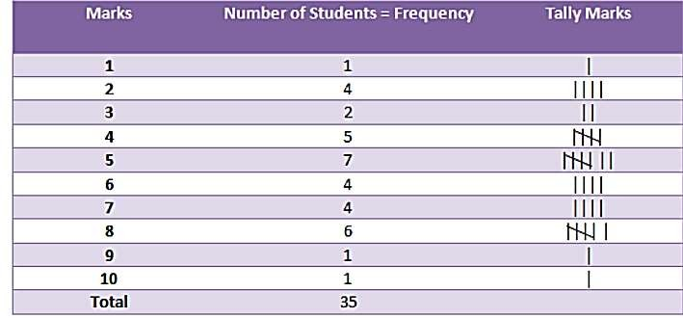
Example:
Below is the marks of 35 students in English test (out of 10). Arrange these marks in tabular form using tally marks. 5, 8, 7, 6, 10, 8, 2, 4, 6, 3, 7, 5, 8, 5, 1, 7, 4, 6, 3,
5, 2, 8, 4, 2, 6, 4, 2, 8, 9, 5, 4, 7, 5, 5, 8.

Slide 5
Example:
Let us consider the following data:
2, 3, 3, 5, 7, 9, 7, 8, 9, 9, 2, 5, 3, 9, 3, 2, 5, 9, 8,
7, 3, 5, 7, 9, 8, 5, 2, 3
Design frequency table for above data.

Slide 6
Example
These are the favorite colors of fifteen 2nd graders.
Red | Blue | Green
Yellow | Red | Yellow
Green | Red | Red
Red | Green | Blue
Blue | Red | Green
Class | Tally | Frequency
Total=

Slide 7
Grouped Frequency Distribution
When the range of the data is large, the data must be grouped into classes
41 | 104 | 112 | 118 | 87 | 95
105 | 57 | 107 | 67 | 78 | 125
109 | 99 | 105 | 99 | 101 | 92

Slide 8
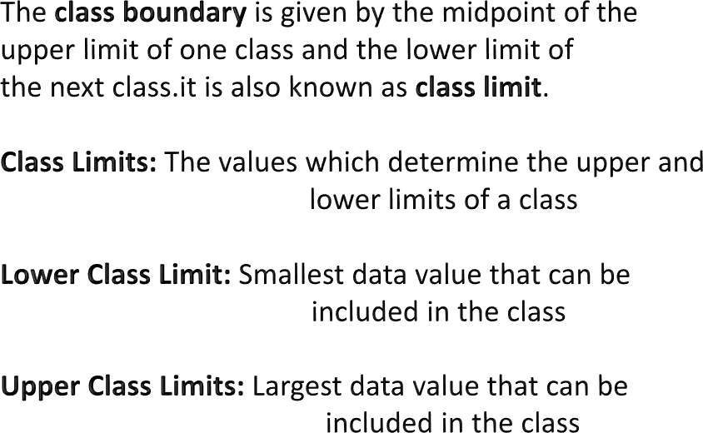
Key Concept

Slide 9
Class Width
The class width is the range of the class.
Can be found by subtracting the lower class limit of one class from the upper class limit of the next class
Class width = Upper boundary – Lower boundary
# of classes

Slide 10
Frequency Distributions cont.
Calculating Class Midpoint or Mark
_{Class midpoint or mark =} Lower limit + Upper limit
2

Slide 11
Rules For Grouped Data
Rule #1: Choose the classes
You will normally be told how many classes you need
Rule #2: Choose Class Width
ALWAYS round up to the next whole number
Rule #3: Mutually Exclusive
This means the class limits cannot contained in more than one class.
overlap or be

Slide 12
Rules For Grouped Data
Rule #4: Continuous
Even if there are no values in a class the class must be included in the frequency distribution. There should be no gaps in a frequency distribution.
(with the exception of a class with zero frequency)
Rule #5: Exhaustive
There should be enough classes to accommodate all of the data
Rule #6: Equal Width
This avoids a distorted view of the data.

Slide 13


Table
Class Widths, and Class Midpoints
Class Limits | Class Width | Class Midpoint
400 to 600 | 200 | 500
601 to 800 | 200 | 700.5
801 to 1000 | 200 | 900.5
1001 to 1200 | 200 | 1100.5
1201 to 1400 | 200 | 1300.5
1401 to 1600 | 200 | 1500.5

Slide 14
Frequency Distributions
Minutes Spent on the Phone
102 | 124 | 108 | 86 | 103 | 82
71 | 104 | 112 | 118 | 87 | 95
103 | 116 | 85 | 122 | 87 | 100
105 | 97 | 107 | 67 | 78 | 125
109 | 99 | 105 | 99 | 101 | 92
Make a frequency distribution table with five classes.
Minimum value = 67 Maximum value =125

Slide 15
Construct a Frequency Distribution Table
Minimum = 67, Maximum = 125 Number of classes = 5
Class width = 11.6 = 12
Class Limits Tally f
67
79
91
103
115
78
90
102
114
126
3
5
8
9
5
Total=30

Slide 16
Example:
Construct a grouped following data :
frequency table for the
8, 10, 43, 15, 22, 34, 23, 45, 28, 49, 30, 21, 29, 17, 33, 39, 41, 48, 33, 25

Slide 17
Example
The total home runs hit by all players of each of the 30 Major League Baseball teams during the 2002 season. Construct a frequency distribution table.

Slide 18


Table
Home Runs Hit by Major League Baseball
Teams During the 2002 Season
Team | Home Runs | Team | Home Runs
Anaheim | 152 | Milwaukee | 139
Arizona | 165 | Minnesota | 167
Atlanta | 164 | Montreal | 162
Baltimore | 165 | New York Mets | 160
Boston | 177 | New York Yankees | 223
Chicago Cubs | 200 | Oakland | 205
Chicago White Sox | 217 | Philadelphia | 165
Cincinnati | 169 | Pittsburgh | 142
Cleveland | 192 | St. Louis | 175
Colorado | 152 | San Diego | 136
Detroit | 124 | San Francisco | 198
Florida | 146 | Seattle | 152
Houston | 167 | Tampa Bay | 133
Kansas City | 140 | Texas | 230
Los Angeles | 155 | Toronto | 187

Slide 19
Solution
Approximate width of each class = ²³⁰ ⁻¹²⁴ = 21.2
5
Now we round this approximate width to a convenient number
– say, 22.

Slide 20


Table Frequency Distribution for the Data of Table
Total Home Runs | Tally | f
124 – 145 | |||| | | 6
146 – 167 | |||| |||| ||| | 13
168 – 189 | |||| | 4
190 – 211 | |||| | 4
212 - 233 | ||| | 3
 |  | ∑f = 30

Slide 21
Relative Frequency and Percentage Distributions
Calculating Relative Frequency of a Category
Re lative frequency of a category = ^{Frequency of that category}
Sum of all frequencies
Calculating Percentage
Percentage = (Relative frequency) x 100

Slide 22
Solution
Table Relative Frequency and Percentage Distributions for Table
Total Home | f | ^{Relative} Percentage
Runs |  | Frequency
124 – 145 | 6 | 0.200 | 20.0
146 – 167 | 13 | 0.433 | 43.3
168 – 189 | 4 | 0.133 | 13.3
190 – 211 | 4 | 0.133 | 13.3
212 - 233 | 3 | 0.100 | 10.0
∑f = 30 Sum = 0.999 |  |  | Sum = 99.9%

Slide 23
Example
After conducting a survey of 30 of your employees, you are left with the following set of data on how many days each employee has taken leave this year:
7, 8, 9, 4, 10, 36, 19, 9, 26, 5, 11, 6, 2, 9, 10, 8, 16, 29, 7, 9, 8, 25, 4, 27, 8, 7, 6, 10, 34, 8
Construct a Frequency Table. Assume you want to divide the data into 5 different classes.

Slide 24
Answer
Class Limits | Tally | Frequency
2-8 |  | 14
9-15 |  | 8
16-22 |  | 2
23-29 |  | 4
30-36 |  | 2
Total: 30

Slide 25


Example
Some what | None | Somewhat | Very | Very | None
Very | Somewhat | Somewhat | Very | Somewhat | Somewhat
Very | Somewhat | None | Very | None | Somewhat
Somewhat | Very | Somewhat | Somewhat | Very | None
Somewhat | Very | very | somewhat | None | Somewhat
Construct a ungrouped frequency distribution table for these data.

Slide 26


Solution
Table
Frequency Distribution of Stress on Job
Stress on Job | Tally |  |  | Frequency (f)
Very | |||| | |||| |  | 10
Somewhat | |||| | |||| | |||| | 14
None | |||| | | |  | 6
 |  |  |  | Sum = 30

Slide 27


Example
Determine the relative frequency and percentage for the data in previous Table
Table
Relative Frequency and Percentage Distributions of Stress on Job
Stress on Job | Frequency (f) | Relative Frequency | Percentage
Very | 10 | 10/30 = .333 | .333(100) = 33.3
Somewhat | 14 | 14/30 = .467 | .467(100) = 46.7
None | 6 | 6/30 = .200 | .200(100) = 20.0
 | Sum = 30 | Sum = 1.00 | Sum = 100

Slide 28
Example
The administration in a large city wanted to know the distribution of vehicles owned by households in that city. A sample of 40 randomly selected households from this city produced the following data on the number of vehicles owned:
5 1 1 2 0 1 1 2 1 1
1 3 3 0 2 5 1 2 3 4
2 1 2 2 1 2 2 1 1 1
4 2 1 1 2 1 1 4 1 3
Construct a frequency distribution table for these data, and draw a bar graph.

Slide 29


Solution
Table Frequency Distribution of Vehicles Owned
Vehicles Owned | Number of Households (f)
0 | 2
1 | 18
2 | 11
3 | 4
4 | 3
5 | 2
 | Σf = 40

Slide 30
Figure Bar graph for Table
20
18
16
14
12
10
8
6
4
2
0
Frequency
No Car
1 Car
2 Cars 3 Cars
Vehicles ow ned
4 Cars
5 Cars

Slide 31
CUMULATIVE FREQUENCY DISTRIBUTIONS
Definition
A cumulative frequency distribution gives the total number of values that fall below the upper boundary of each class.

Slide 32
Calculating Cumulative Relative Frequency and Cumulative Percentage
Cumulative relative frequency= ^{Cumulative frequencyof a class}
Tota lobservations in the data set
Cumulative percentage= (Cumulative relative frequency)⋅100

Slide 33


Table
Cumulative Relative Frequency and
Cumulative Percentage Distributions for
Home Runs Hit by baseball Teams
Class Limits | Cumulative Relative Frequency | Cumulative Percentage
124 – 145 | 6/30 = .200 | 20.0
124 – 167 | 19/30 = .633 | 63.3
124 – 189 | 23/30 = .767 | 76.7
124 – 211 | 27/30 = .900 | 90.0
124 - 233 | 30/30 = 1.00 | 100.0

Slide 34
CUMULATIVE FREQUENCY DISTRIBUTIONS cont.
Definition
An ogive is a curve drawn for the cumulative frequency distribution by joining with straight lines the dots marked above the upper boundaries of classes at heights equal to the cumulative frequencies of respective classes.

Slide 35
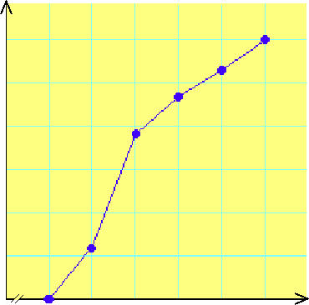
Figure
Ogive for the cumulative frequency
distribution in Table
30
25
20
15
10
5
Cumulative frequency
123.5 145.5 167.5 189.5 211.5 233.5
Total home runs

Slide 36
Shape
A graph shows the shape of the distribution.
A distribution is symmetrical if the left side of the graph is (roughly) a mirror image of the right side.
One example of a symmetrical distribution is the bell-shaped normal distribution.
On the other hand, distributions are skewed when scores pile up on one side of the distribution, leaving a "tail" of a few extreme values on the other side.

